Slide 1
Accessing Digital Materials
Penny Everett
Web Accessibility Consultant
VerseOne Technologies Ltd
MIND THE GAP
1

Slide 2
Main impairments
Make sure you have a copy of the Personas
MIND THE GAP
Photographs of personas by courtesy of Graur Razvan Ionut, Yarm Jeroen van Oostrom, Maggie Smith, and Tina Phillips http://www.freedigitalphotos.net/
2

Slide 3
Dyslexia exercise
Ew evah tliub pu a thgis yralubacov fo ytfif dnasuoht sdrow – ton yb enoemos gnillet su ytfif dnasouht semit tahw a drow si, tub yb gnizisehtopyh eht ytitnedi fo wen sdrow taht ew teem ni tnirp dna gnitset taht ruo sesehtopyh ekam esnes ni eht txetnoc.
3

Slide 4
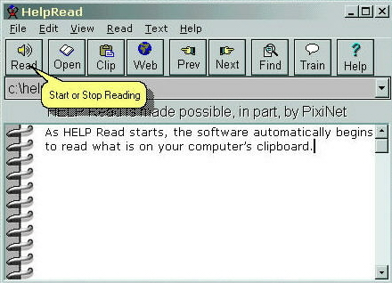
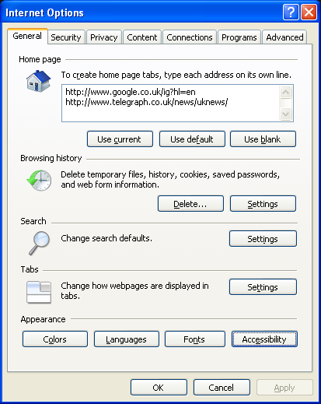
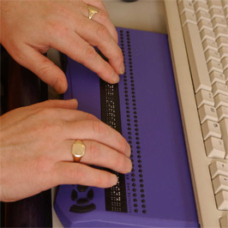
Assistive/Adaptive Technology
4
Notes:
http://www.washington.edu/doit/Video/comp_acc.html

Slide 5
Users rely solely on good web design and accessible content
Vision impaired users will often need to make the text larger
Tab only users will need to see where they are currently focused
Born deaf users will need ‘Plain English’
Hard of hearing like deaf users will need content authors to be aware that they need audio and video transcripts and transcriptions.

Slide 6
Some stats…
100 people go blind every day.
10% of people who have hearing loss were born deaf.
1 in 10 people have some form of dyslexia.
Are you aware of the number of students in your College who have impairments and the breakdown of those stats?
6

Slide 7
The Equality Act 2010
Direct discrimination is when someone is treated worse than another person because of a protected characteristic.
Indirect discrimination can happen when there is a policy for everyone which disadvantages people with a PC.
Discrimination arising from occurs when a disabled person is treated unfavourably because of something connected with their disability.
Direct
Indirect
Arising from
A lack of financial resources alone is unlikely to be sufficient justification.
7
Notes:
Protected characteristics (PC)

Slide 8
What is WCAG 2.0?
Single A 25 Success Criteria
Double AA 13 Success Criteria
Triple AAA 23 Success Criteria
8

Slide 9
4 main headings for success criteria…
Every aspect of the website can be tested!
P Perceivable (available to one sense)
O Operable (keyboard only?)
U Understandable
R Robust (future proofed & AT friendly)
9
Notes:
Definition of pour: flowing out of and into…

Slide 10
Perceivable (distinguishable)
Indirect
1.4.3 Contrast (Minimum)
The visual presentation of text and images has a contrast ratio of at least 4.5:1.
Ipsum Lorem
dolor amet magna online
Ipsum Lorem
Dolor amet magna online
Ipsum Lorem
Dolor amet magna online
More…
More…
More…
Ipsum Lorem
Dolor amet magna onlie
Ipsum Lorem
Dolor amet magna online
Ipsum Lorem
Dolor amet magna online
More…
More…
More…
Ipsum Lorem
dolor amet magna online
Ipsum Lorem
Dolor amet magna online
Ipsum Lorem
Dolor amet magna online
More…
More…
More…
Ipsum Lorem
Dolor amet magna onlie
Ipsum Lorem
Dolor amet magna online
Ipsum Lorem
Dolor amet magna online
More…
More…
More…
10
WCAG 2.0 FAILURE Double A

Slide 11
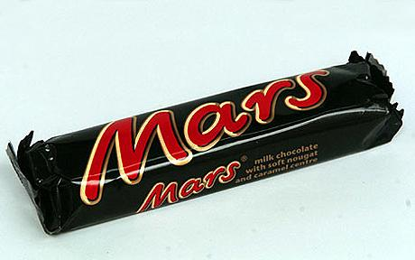
Motor impairment
11

Slide 12
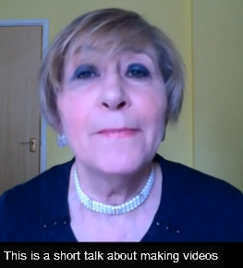
Perceivable (time-based media)
Indirect
An alternative for time-based media is provided that presents equivalent information.
Barb
Born deaf and uses sign language which is very different from written sentences.
Video should include captioning for the deaf with any relevant sound explained
This includes YouTube videos that you refer to on your website.
http://www.youtube.com/watch?v=-_ZZsrpBulM
Keywords: VerseOne Tutorial
12
WCAG 2.0 FAILURE Single A

Slide 13
Bad examples
MIND THE GAP
YouTube automatic captions to help the deaf “enables us” the caption said
“in a boy’s ass”
Alternative text for an image left blank and reads out the file name:
“buscon23062003.jpg”

Slide 14
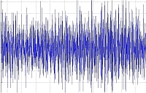
Perceivable (time-based media)
Indirect
Hanna
hard of hearing but can hear if low background noise.
Contrast between background and foreground noise is at least 20 decibels.
14
WCAG 2.0 FAILURE Triple A

Slide 15
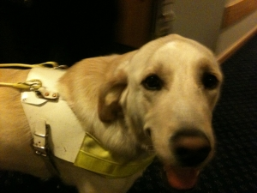
Perceivable (adaptable)
Indirect
1.3.1 Info and relationships
Information, structure, and relationships conveyed through presentation can be programmatically determined or are available in text.
This article is all about the various treatments that are available in our walk in centre.
Depending on the severity of your ailment and whether or not you have been referred by your GP, you will be seen within 2 hours.
Here is an example of using heading format to emphasise a paragraph.
Headings should be formatted according to their hierarchy and text should be formatted as body text
Adult Walk-in centre
We can still expect to see quite a variety in the average urban garden.
X-Ray
Our X-ray centre is available from 8:30am to 5pm week-days.
15
WCAG 2.0 FAILURE Single A

Slide 16
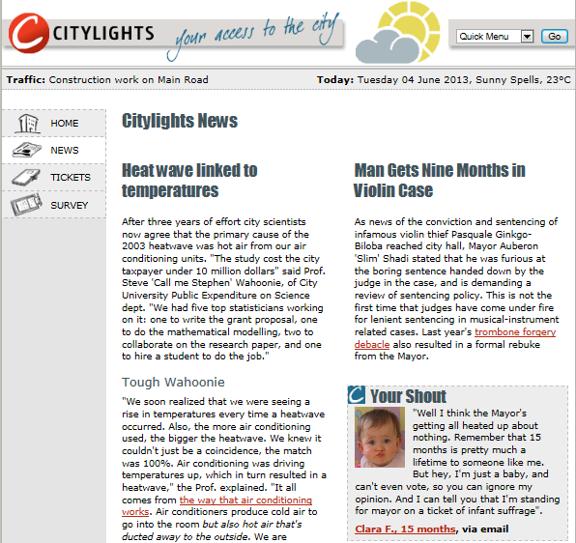
16
http://www.w3.org/WAI/demos/bad/after/news.html

Slide 17
Perceivable (text alternatives)
Indirect
Screen readers cannot explain an image.
It can only read the alternative text if it has been added.
Always let the blind user know about any essential text that has been included as part of an image.
Don’t forget the Digital Inclusion Conference
Alt-txt: “diary page and magnifier”
Don’t forget the Digital Inclusion Conference on 6-7 December
Alt-txt: “6 to 7 December Digital Inclusion Conference reminder”
17
WCAG 2.0 FAILURE Single A – SC 1.1.1

Slide 18
Perceivable (adaptable)
Indirect
CSS, spans and Layout tables
Layout tables must use correct mark-up to separate table data from column or row headers.
1.3.1 Info and relationships
Information, structure, and relationships conveyed through presentation can be programmatically determined or are available in text.
18

Slide 19
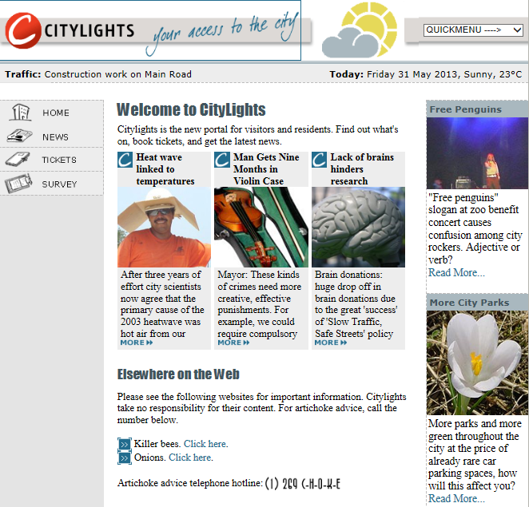
19
http://www.w3.org/WAI/demos/bad/before/home.html

Slide 20
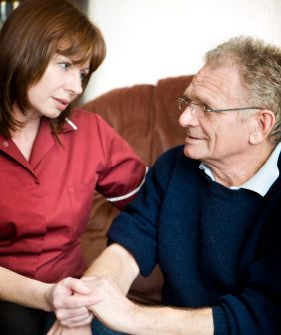
Perceivable (time-based media)
Indirect
An alternative for time-based media is provided that presents equivalent information.
Video should include the scenario explained to the blind in a transcript.
Seated mental health care nurse looking sympathetic and holding hands of elderly gentleman. He says “I’m worried about the cost of care”.
http://dl.groovygecko.net/anon.groovy/clients/rnib/blueplanet.mp3
20
WCAG 2.0 FAILURE Double A failure

Slide 21
Perceivable (text alternatives)
Indirect
System requirements
Home
About Us
News
Contact Us
System requirements
System requirements
Essential information
21

Slide 22
Operable (navigable)
Indirect
To find out more Click here...
What we expect of you in Year 1 More...
Available in our “Your first year at College” Leaflet
2.4.4 Link Purpose (In Context)
The purpose of each link can be determined from the link text alone.
22
WCAG 2.0 FAILURE Single A

Slide 23
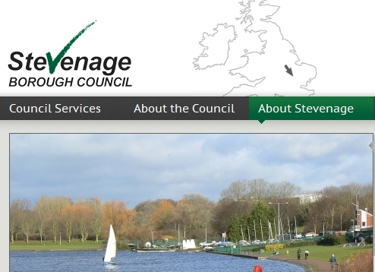
Operable (Navigable)
Indirect
Linda
Has RSI and cannot use a mouse
2.4.7 Focus Visible
Any keyboard operable user interface has a mode of operation where the keyboard focus indicator is visible.
About Us
About Us
23
WCAG 2.0 FAILURE Double A

Slide 24
Operable Motor Impaired!
Indirect
Suggested Book List
2. The Lord of the Rings, JRR Tolkien 2. Pride and Prejudice, Jane Austen 3. His Dark Materials, Philip Pullman 4. The Hitchhiker's Guide to the Galaxy, Douglas Adams 5. Harry Potter and the Goblet of Fire, JK Rowling 6. To Kill a Mockingbird, Harper Lee 8. Nineteen Eighty-Four, George Orwell 9. The Lion, the Witch and the Wardrobe, CS Lewis 10. Jane Eyre, Charlotte Brontë 11. Catch-22, Joseph Heller 12. Wuthering Heights, Emily Brontë 13. Birdsong, Sebastian Faulks 14. Rebecca, Daphne du Maurier 15. The Catcher in the Rye, JD Salinger 16. The Wind in the Willows, Kenneth Grahame 17. Great Expectations, Charles Dickens 18. Little Women, Louisa May Alcott 19. Captain Corelli's Mandolin, Louis de Bernieres 20. War and Peace, Leo Tolstoy 21. Gone with the Wind, Margaret Mitchell 22. Harry Potter And The Philosopher's Stone, JK Rowling 23. Harry Potter And The Chamber Of Secrets, JK Rowling 24. Harry Potter And The Prisoner Of Azkaban, JK Rowling 25. The Hobbit, JRR Tolkien
Simon – aged 31
has problems with fine movement.
24
Usability

Slide 25
Understandable (predictable)
Indirect
3.2.2 On Input
Changing the setting of any user interface component does not automatically cause a change of context unless the user has been advised of the behaviour.
Course Guidance Notes
Course Stationery?
(PDF file 4MB)
(opens in a new window)
25
WCAG 2.0 FAILURE Single A

Slide 26
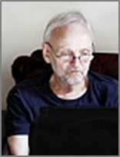
Not ensure forms are easy to use!
Indirect
Associate labels with text boxes
Give adequate instructions before user inputs information
Radio buttons grouped in a field set
Group of check boxes also in a field set eg Invoice address and Delivery address
First Name
|
Last Name
Address
Please enter Post Code in separate box
Post Code
e-Mail
Tel
Subscribe to our newsletter
Yes
No
Tick all that apply
Mens
Kids
Ladies
Pets
26
WCAG 2.0 FAILURE Single A
Notes:
<label for= "fname">First Name </label>
<input type="text" name="fname">
Forms need to be easy to complete and easy to check or correct.
To help users find the correct field for inputting a response we need to tie the text label (indication of what is required) to the relevant input field. For this we use the <label> element.
We also need to provide a mechanism for users to check what they have entered in the form, and to make any corrections before submission. This requires a server that runs an application such as PHP or ColdFusion. The simplest method is to make the form “action” point to another web page that displays the results of the input so that the user can confirm the details, or go back to the form to make changes. Better solutions provide help to the user by identifying empty fields, or inputs that are not in the required format. If suggestions are used - make it clear which input field requires the data.

Slide 27
Perceivable (print disability)
Indirect
Web Designer’s need to ensure that the contrast ratio between text and background is sufficient
This is Dawn’s preferred contrast ratio. It helps her to read the information and she has her own stylesheet.
The contrast ratio in this example is would not meet Single A conformance because it is extremely low. .
27
WCAG 2.0 FAILURE: Double-A – SC 1.4.3

Slide 28
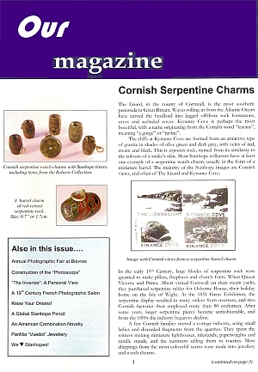
Robust (print disability)
Indirect
4.1.1 Parsing & 4.1.2 Name, Role, Value
Maximize compatibility with current and future user agents, including assistive technologies.
Visually impaired
Cognitively impaired
Physically impaired (can’t use a mouse or turn pages)
28
WCAG 2.0 FAILURE Single A

Slide 29
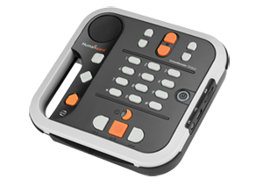
DAISY Digital Accessible Information System
As long as the formatting of a web page, or a document is done correctly various Assistive/Adaptive software and hardware can relay it to an impaired user.
Many print disabled users need to be able to change the font colour, font size and background colour.
Research confirms that highlighting text as it is spoken can help learners pay attention and remember more. Cited in Silver-Pacuilla and Fleischman, 2006 p.84
Robust (compatible)
Single A

Slide 30
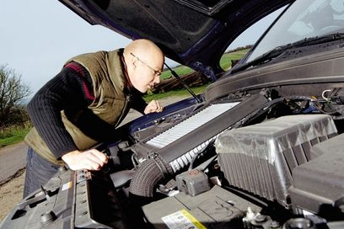
Is there a quick fix?
No!
but there is a quick way to find out if your web service is not accessible…
30

Slide 31
Audits and User Testing identify issues
Deal with the outcome
Train staff
Embed accessibility awareness
Arrange user testing…
31

Slide 32
Who monitors the gap?
MIND THE GAP
Students - Negative They will let you know if they are having difficulty either through personal contact or through organisations such as Fix the Web, the RNIB or Action on Hearing Loss, or by going through the complaint process.
A professional Auditor - Positive A Web Accessibility Auditor will let an organisation know the current state of their website and can regularly keep an eye on any contraventions with WCAG 2.0 that could be made by the Content Authors.
A trained member of staff - Positive Who cascades their knowledge to all relevant members of staff including new staff as and when they arrive and has a system in place which “approves” the uploading of content before it is published.

Slide 33
What happens if you can’t close the gap?
MIND THE GAP
A court of law will take into consideration the resources of an organisation such as the number of staff and the financial resources.
If the Success Criteria in WCAG 2.0 cannot be met and the organisation can justify why this is so or can give a time scale when it will be rectified then it must be stated on the website.
Basically you should offer interim assistance in some way to the disabled user such as:
“Contact your Course Tutor who will do their utmost to help you”.
If an individual knowingly uploads content or develops a website that is not accessible they are culpable in a Court of Law.

Slide 34
Meeting the Standards
WCAG 2.0 downloaded into Word is 250 pages long and full of links.
Often only 5-10% of a Course Tutor’s job is uploading to the web.
Without proper accessibility training they are in danger of breaking the law.
34

Slide 35
Any questions...?
We hope you enjoyed your brief tour into avoiding the pitfalls.
Penny Everett
Web Accessibility Consultant
penny.everett@verseone.com
VerseOne Technologies Limited
35

