Slide 1
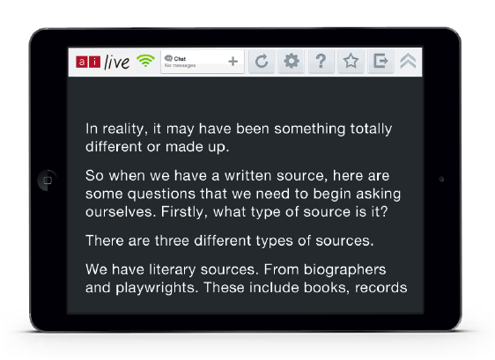
Introduction to Ai-Live:
Verbatim Captions
and Transcripts
Denise Bob-Jones
Business Development Executive
Ai-Media UK

Slide 2
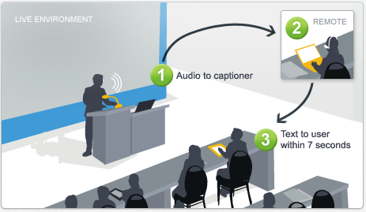

How It Works

Slide 3
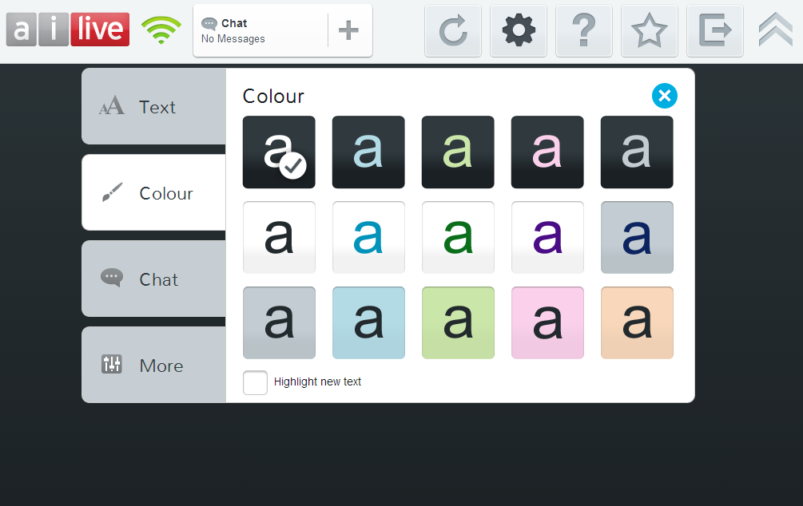
Ai-Live Features

Slide 4
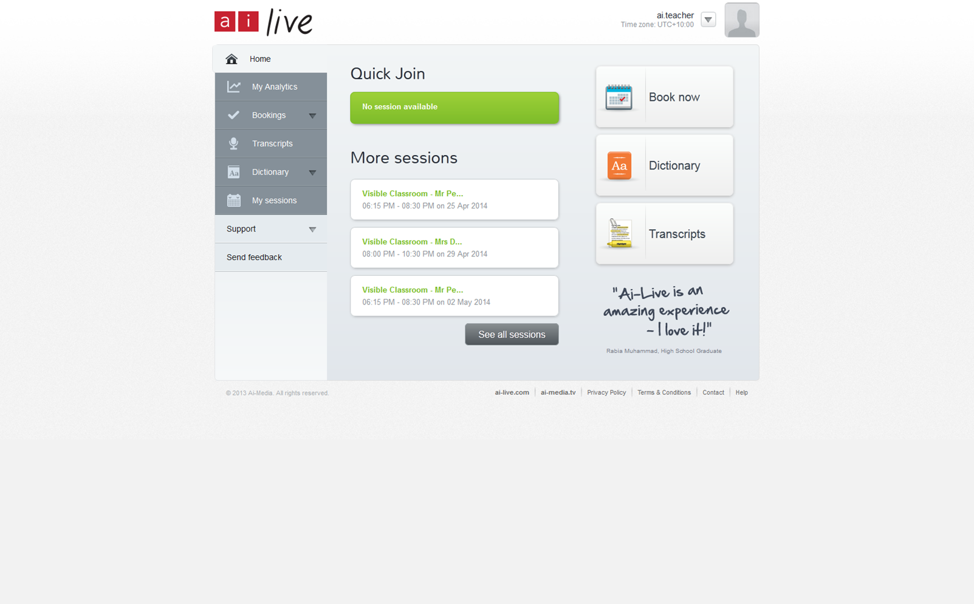
The Ai-Live Portal

Slide 5








Our clients

Slide 6
Our clients
“It transformed my life. There’s no need for anybody to be present, besides me, my laptop, internet connection and the right microphone. I have perfected this set up process so that it only takes me a few minutes to have it ready.
I can now come to classes at the time other students do. Communication has become worry-free. And thanks to Ai-Media’s booking system I can just enter when I need support and I can count on it to happen.”
- Fred Suter, University of Southampton, UK

Slide 7
Our clients
“Ai-Live has helped me catch up on any missed bits of lectures and allowed me to review the lecture again for revision purposes.
It is easy to use and the captions are always prompt on the day. I would recommend Ai-Live.”
- Walid Hassoon, Wolverhampton University, UK

Slide 8
Our clients
“I think Ai-Live is awesome. Having Ai-Live for my lectures meant that I was able to access the lecture anytime and anywhere. Sometimes I am not able to attend lectures physically because of my medical condition. Now I do not have to worry about missing out anymore as I can access the lecture by logging onto Ai-Live on my home computer.
I also do not have to worry about carting around a black box anymore. It is just a matter of getting the mobile to the lecturer and away we go.”
- Milly Burrows, La Trobe University, Australia

Slide 9
Ai-Live Benefits
Students
Real-time access and inclusion for deaf and hard of hearing students;
Encourages greater participation and engagement;
An easy to navigate portal and quick booking system;
Captions can be accessed via a portable web enabled device e.g. tablet, laptop, mobile;
Transcripts from captions:
  Eliminate the need to make notes and allow students to focus on content;
  A useful learning aid to review content;
  A revision tool.

Slide 10
Ai-Live Benefits
Lecturers
Confidence that students have real-time access to the full content of lectures;
Confidence that students can participate and feel more engaged in lectures and classes;
Unobtrusive, user friendly technology.

Slide 11
Thank you.
Questions and Feedback?

